Slide 1
System Programming
Homework 3

Slide 2
TODOs
Link new client
Time synchronization
Multiple I/O

Slide 3
Link New Client
Handle empty new client link
Download file from server if it needed
Synchronize attribute change on regular file(only for this homework)

Slide 4
Time Synchronization
Clients and server may be in different time zone
Server keep all time difference and adjust time when doing file synchronization

Slide 5
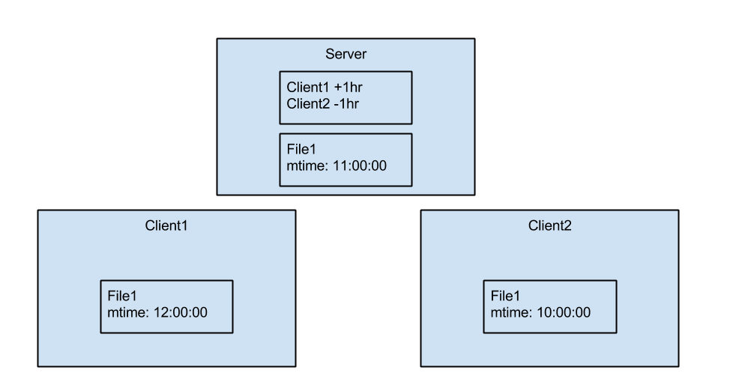
Time Synchronization

Slide 6
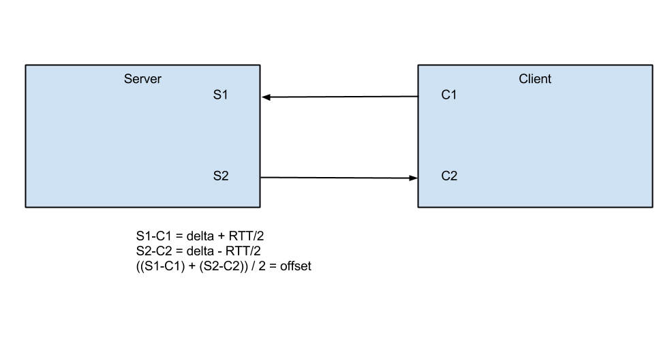
Time Synchronization

Slide 7
Multiple I/O
Server need multiple I/O
Serve multiple clients
Client need multiple I/O
Handle server requests
Handle inotify events

Slide 8
Bouncing
Happen when multiple clients with the same account
Client C₁ update
Client C₁ inotify event triggered
Client C₁ update to server
Server push change to Client C₂
Client C₂ update file
Client C₂ inotify event triggered
Simply assume that updating from user and server may not happen at the same time.
Ignore inotify events after download files

Slide 9
Test Scenario
Start server
Start client C₁ with some files in home directory
Start client C₂ with an empty home directory
The accounts of client C₁ and client C₂ are the same.
At the moment, client C₂ will download files from server
Touch a file in client C₁ home directory
Stat the file in client C₂

Slide 10
Contact
Email: r01922084@ntu.edu.tw
p2: wmin0
Please use prefix [SP_HW3] at the title. Thanks.

